Slide 1
Ancient Egypt
By Evan , Cara , Hollie , Aoife ,

Slide 2
Pyramids
The first pyramid was built as the burial place of King Djoser .
The largest pyramid of all is the Great Pyramid of Giza , built for King Khufu in 2589 B.C.
Later pyramids contained inscriptions of spells to help the Pharaoh in the afterlife.

Slide 3
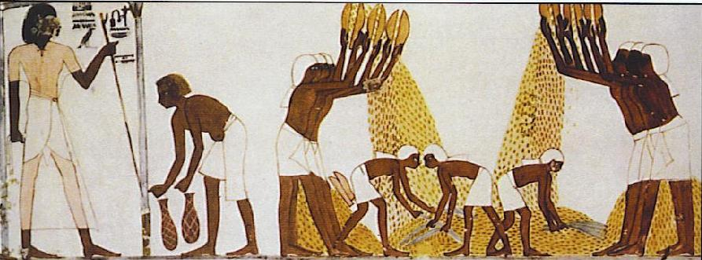
Slaves
In ancient Egypt 80% of the population were slaves or servants. People could become slaves if they did not pay their debts. Other people sold themselves to slavery because they had no money for food and homes .

Slide 4
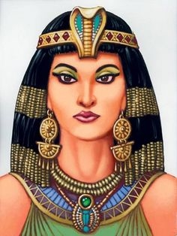
Cleopatra
The name is derived from the Greek name Cleopatra which meant `` she who comes from glorious father`` or ``glory of the father``. Cleopatra was the last active pharaoh of Ptolemaic Egypt, shortly survived as pharaoh by her son Caesarion.

Slide 5
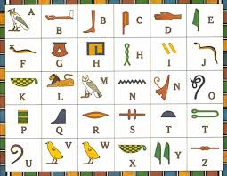
WRITING
Hieroglyphics were carved or painted by the priests and scribes. At first Egyptian hieroglyphics were simple pictures, later the hieroglyphics came to mean more. For example, the picture of a house meant the sound ‘pr’ because that was the Egyptian word for house.

Slide 6
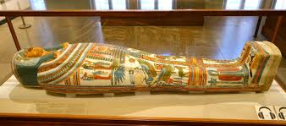
Mummies
Over the past thousands of years lots of the mummies were destroyed. Some were burned for fuel, some were ground into magical potions and some were destroyed by treasure hunters. All the organs except the heart were taken out of the body. The Egyptians believed that the heart was the centre of intelligence.

Slide 7
River Nile
Thousands of years ago, the first farmers worked on the land near the river Nile. The Nile is one of the greatest and longest rivers in the world. It flows to the sea through Egypt. The land around the river was always very fertile and good for farming. This river is very important for the Egyptians.

Slide 8
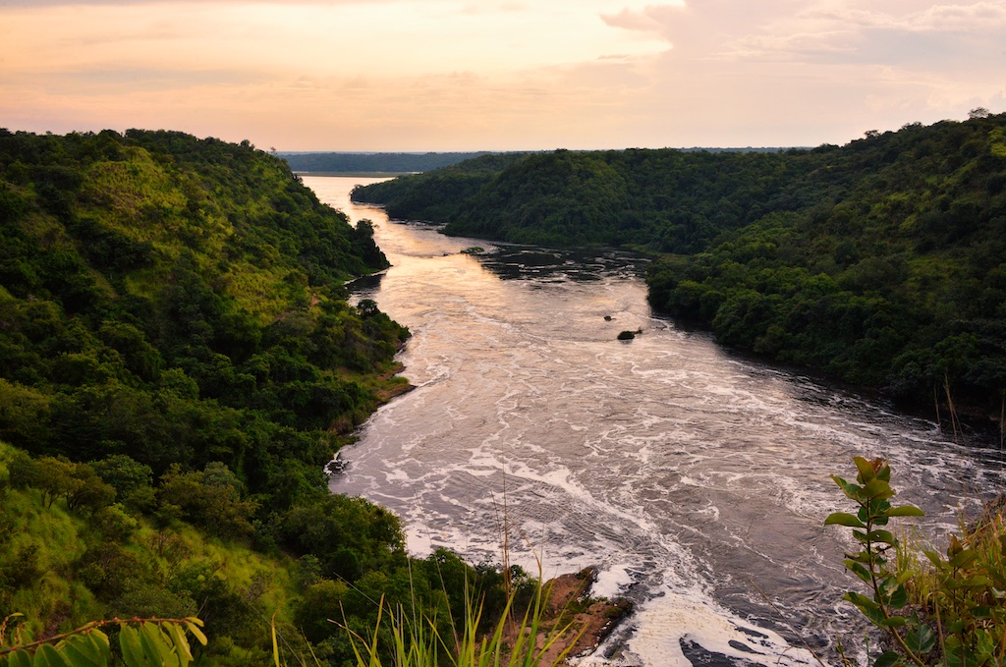
The river Nile.

Slide 9
TOYS
Egyptians were wood carvers . They made pull along toys . Senet was a very popular board game. Other games involving dice, boards and moving pieces were played with. They also had dolls and other things . Spinning tops were also popular in Ancient Egypt.

Slide 10
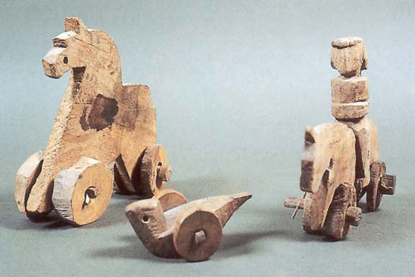
tOYS

Slide 11
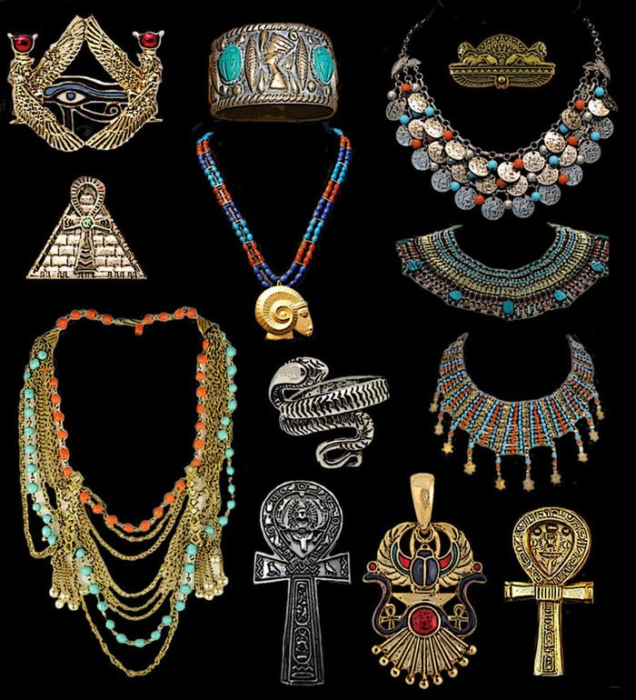
Jewellery
Jewellery was beautiful and colourful and was made out of copper and gold wire coloured glass beads and gemstones. Rings, earrings and bracelets for the wrists, upper arm and ankle were popular.

Slide 12
Tutankhamun
On 4th November 1922, Howard Carter, an archaeologist, found the hidden tomb of Pharaoh Tutankhamun . The tomb had four rooms, more than 3500 items were found in the rooms. He was just nine years old when he became a Pharaoh.

Slide 13
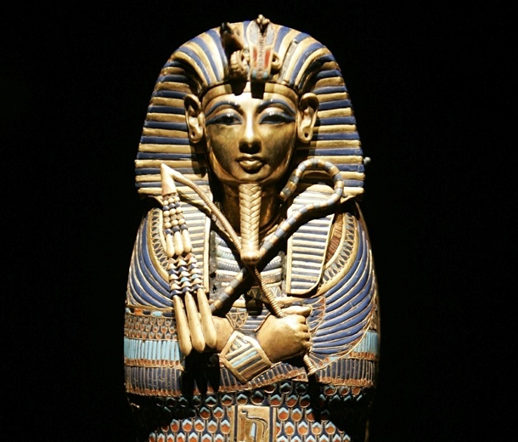
Tutankhamun
Known as King Tut.

Slide 14
Were you listening?
What age was Tutankhamun when he became a pharaoh?
What type of jewellery did they wear?
Does the river Nile flow through the whole of Egypt?
When did Howard Carter discover Tutankhamun’s tomb?
Where the queens buried in the huge pyramid, or the small ones?
What was Cleopatra’s son’s name ?
Give me a name of a type of pyramid?

Slide 15
Hope you liked our project about ANCIENT EGYPT!

