Slide 1
Ancient Egypt
By Shauna Megan Noah and Ava

Slide 2
Pyramids
The pyramids are the stone tombs of Egypt’s kings – the Pharaohs.
There are around 138 Egyptian pyramids. Some of them are huge.
The base of a pyramid was always a perfect square.

Slide 3
CLEOPATRA
Cleopatra was the only female pharaoh.
She was married to her brother.
She let an asp (snake) bite her arm
She was born in 69bc and died in 30 bc.

Slide 4
CLEOPATRA
Cleopatra was not Egyptian she was Greek.
Cleopatra got her husband to kill her sister.
Cleopatra was exiled by her younger brother Ptolemy.
She had four children but only one survived.
She owned a perfume factory .
Fun Facts
Cleopatra

Slide 5
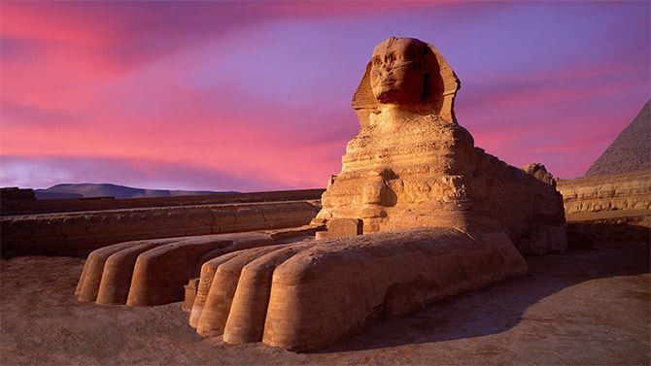
SPHINX

Slide 6
SPHINX
A sphinx is a mythological creature with the body of a lion and the head of a person.
In Ancient Egypt a lot of times the head was that of a pharaoh or a god.

Slide 7
pyramids
The pyramids that we see in Egypt continue to be ‘wonders of the world’ .they were built thousands of years ago and yet still stand.
The ancient Egyptians created the pyramids as burial tombs to honour their pharoahs and since they believe them to be both man and god ,they made the pyramids in a grand style.

Slide 8
AMULETS

Slide 9
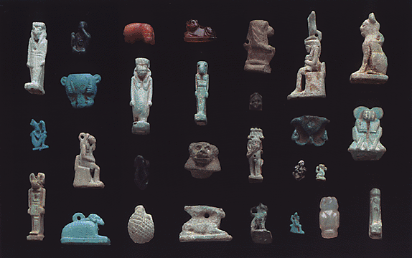
AMULETS
pictures
FUN FACTS
An amulet is an item that
Someone might wear or carry
around with them in the belief
that it will bring them good LUCK.
Before the age of the pharaohs amulets were usually in the form of animals.

Slide 10
WRITING
The Egyptian writing called hieroglyphics used pictures to represent different objects , actions ,sound or ideas.
There were more than 7oo hieroglyphs .

Slide 11
POP QUIZ
1. Was Cleopatra Greek, French
, German or Egyptian?
2.What factory did Cleopatra own?
3. Was she exiled by her brother or
sister?
4.Was her brother’s name Ptolemy or Ra?

Slide 12
KING TUT
What was King Tut’s mother’s name?
Was Tutankhamun richer or poorer than other kings?
Was his father dead or alive when he was a pharaoh?

Slide 13
THANK YOU FOR READING OUR PROJECT.

Slide 14
THE END

